Slide 1

Correcting the Analytical Null for Discrete Mutual Information
By Daniel Zhao (Master of Computer Science)
Supervised by Assoc. Prof. Joseph Lizier
Notes:
Hi we

Slide 2
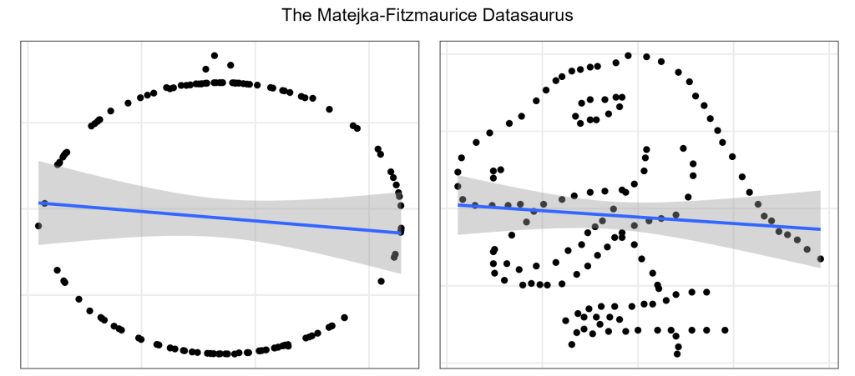
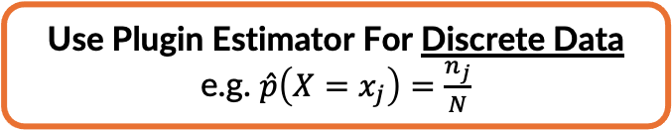
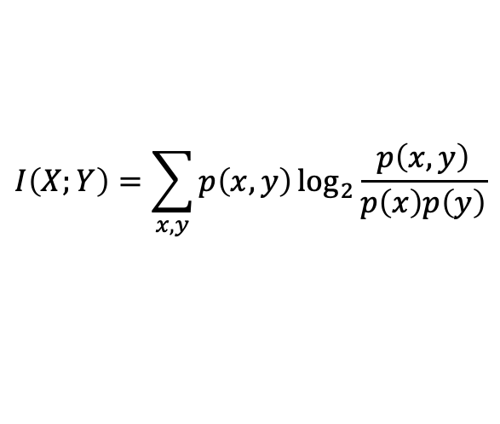

What is Mutual Information?
Mutual information is a measure from information theory that quantifies how much knowing one variable reduces uncertainty about another. A larger value indicates a stronger statistical dependence between the two.
$$I\left(X;Y\right)=\sum_{x,y}{p\left(x,y\right)\log_{2}{\frac{p\left(x,y\right)}{p\left(x\right)p\left(y\right)}}}$$
Fun Fact!
If X and Y are Gaussian, Mutual Information is a Function of Pearson Correlation
Measures Non-Linear Relationships¹
Model-free measure
We only need to know the joint probability distribution of X and Y
Estimate $p\left(x\right)$, $p\left(y\right)$, and $p\left(x,y\right)$ using data
Pearson Corr: -0.06
Mutual Info: 0.79
Pearson Corr: -0.07
Mutual Info: 0.56
Use Plugin Estimator For Discrete Data
e.g. $\hat{p}\left(X=x_{j}\right)=\frac{n_{j}}{N}$
1. Image sourced from https://mattiheino.com/2019/05/10/correlation/. Numbers are for illustrative purposes.
Notes:
Thus, we have developed the following research question
To what extent do dependencies exist among the stock price movements of Australia’s major banks, and do these dependencies persist after conditioning on broader stock market and macroeconomic influences?
To address this research question, we are going to use mutual information for the first part of the question and conditional mutual information for the second part of the question.
In particular, we are going to use these information theoretic tools from a statistical point of view, and interpret them as non-linear correlations and non-linear partial correlation
So what do these information theoretic tools tell us?
Well suppose we find that there is Low MI and Low CMI, then this is the best case as it shows us that the price movements between these banks are relatively independent, and so there is still diversification benefits in having all 5 banks in the ASX200
If there is high MI and low CMI, then we can consider this the moderate case as it shows us that most of the price dependency related market and macro factors, which is also known as systematic risk. This is generally considered okay from a portfolio finance POV as systematic risks is not something that we can mitigate through diversification anyways. These are the risks that the ASX200 index is going to face regardless of whether it is concentrated on these 5 banks.
However, if we find high MI and High CMI, then this is the worst case, as the price dependency between these banks is likely related to some sector specific risks, also know as idiosyncratic risk. This is problem for the ASX200 index because now up to 30% of its volatility is related to idiosyncratic risks that should only face the banking sector.

Slide 3
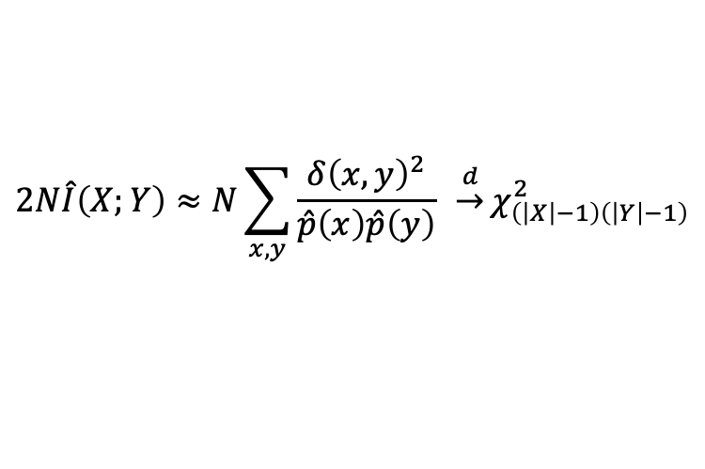
Motivation: Significance Testing
Two principal approaches are commonly used to test the statistical significance of Mutual Information. Each approach involves distinct trade-offs that affect the speed and reliability of the resulting inference.
Resampled Null Distribution
Analytical Null Distribution
How It Works
Resample (or shuffle) one variable to destroy X-Y dependence
Recompute MI for each resample to build empirical null
Compare observed MI against empirical null percentiles
How It Works
Derive MI’s null distribution mathematically
Use asymptotic theory (e.g. χ²) for p-values
No resampling required, only need alphabet size and sample size
X | Y
a | a
a | a
b | b
b | b
c | c
c | c
X | Y
a | a
a | c
b | a
b | b
c | b
c | c
$$2N\hat{I}\left(X;Y\right)≈N\sum_{x,y}{\frac{δ{\left(x,y\right)}^{2}}{\hat{p}\left(x\right)\hat{p}\left(y\right)}} \underset{→}{d}χ_{\left(\left|X\right|−1\right)\left(\left|Y\right|−1\right)}^{2}$$
✓ Strengths
Industry Standard for Significance Testing
Easy to implement and understand
✗ Weaknesses
Computationally expensive (thousands of resamples)
Cost of significance testing dominates the cost of estimation
✓ Strengths
Computationally fast: closed-form p-values
Only need to know alphabet size and sample size
✗ Weaknesses
Works poorly in small samples or skewed distribution
Need dense sampling across the joint distribution of X and Y
Notes:
Now before we get started, I am sure we have all heard on the news about how the US stock market is increasingly concentrated on a group of tech stocks known as the magnificent 7. However, little known is that our stock market similarly concentrated on a group of banking stock, as shown the screen here.
These 5 major banks make up to anywhere between 25% to 30% of our ASX200 index. In particular, CBA alone accounts for more than 10% of the index, and is now the worlds most expensive retail bank on a price to earning and price to book ratio.
Now, having the ASX200 being concentrated in these 5 stocks is problematic because it creates a market distortion effect, if there is strong share price dependence between these banks, the they will disproportionately drive the returns and volatility of the ASX200. Thus it will reduces the diversification benefits of investing in the ASX200 index directly.
Most Australians should be concerns as a lot of household wealth might be tied up in the ASX200 index through our investments in assets such as superannuation funds and index ETFs

Slide 4
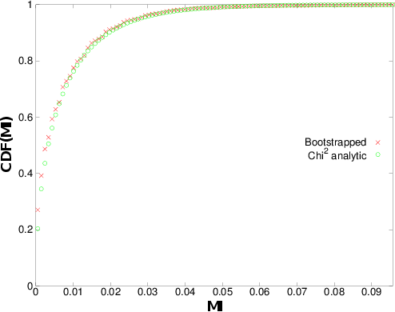
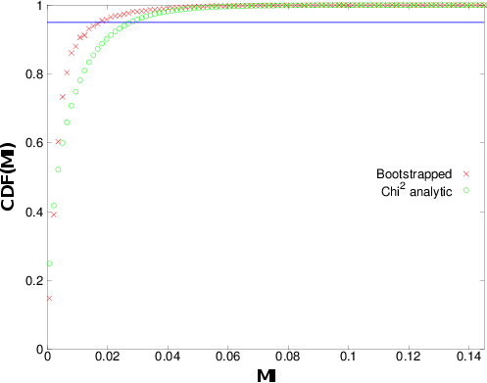
Motivation: Analytical Null Shortfall
The standard chi-square analytical null is convenient but can be unreliable under small samples or skewed marginal distributions. This is the gap that the present project seeks to address.
100 samples of unrelated binary variables
Balanced Case
Each binary variable is distributed with
p(0) = 0.5, p(1) = 0.5
Skewed Case
Each binary variable is distributed with
p(0) = 0.05, p(1) = 0.95
Notes:
Now before we get started, I am sure we have all heard on the news about how the US stock market is increasingly concentrated on a group of tech stocks known as the magnificent 7. However, little known is that our stock market similarly concentrated on a group of banking stock, as shown the screen here.
These 5 major banks make up to anywhere between 25% to 30% of our ASX200 index. In particular, CBA alone accounts for more than 10% of the index, and is now the worlds most expensive retail bank on a price to earning and price to book ratio.
Now, having the ASX200 being concentrated in these 5 stocks is problematic because it creates a market distortion effect, if there is strong share price dependence between these banks, the they will disproportionately drive the returns and volatility of the ASX200. Thus it will reduces the diversification benefits of investing in the ASX200 index directly.
Most Australians should be concerns as a lot of household wealth might be tied up in the ASX200 index through our investments in assets such as superannuation funds and index ETFs

Slide 5
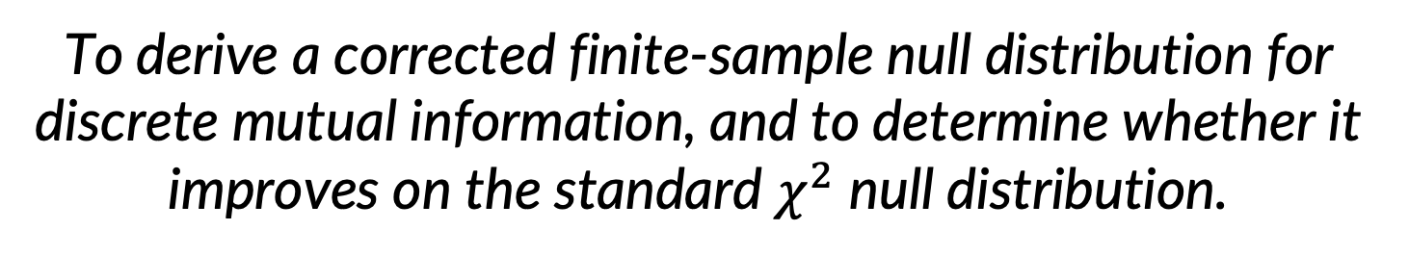
Research Problem
To derive a corrected finite-sample null distribution for discrete mutual information, and to determine whether it improves on the standard$χ^{2}$ null distribution.
Notes:
Now before we get started, I am sure we have all heard on the news about how the US stock market is increasingly concentrated on a group of tech stocks known as the magnificent 7. However, little known is that our stock market similarly concentrated on a group of banking stock, as shown the screen here.
These 5 major banks make up to anywhere between 25% to 30% of our ASX200 index. In particular, CBA alone accounts for more than 10% of the index, and is now the worlds most expensive retail bank on a price to earning and price to book ratio.
Now, having the ASX200 being concentrated in these 5 stocks is problematic because it creates a market distortion effect, if there is strong share price dependence between these banks, the they will disproportionately drive the returns and volatility of the ASX200. Thus it will reduces the diversification benefits of investing in the ASX200 index directly.
Most Australians should be concerns as a lot of household wealth might be tied up in the ASX200 index through our investments in assets such as superannuation funds and index ETFs

Slide 6
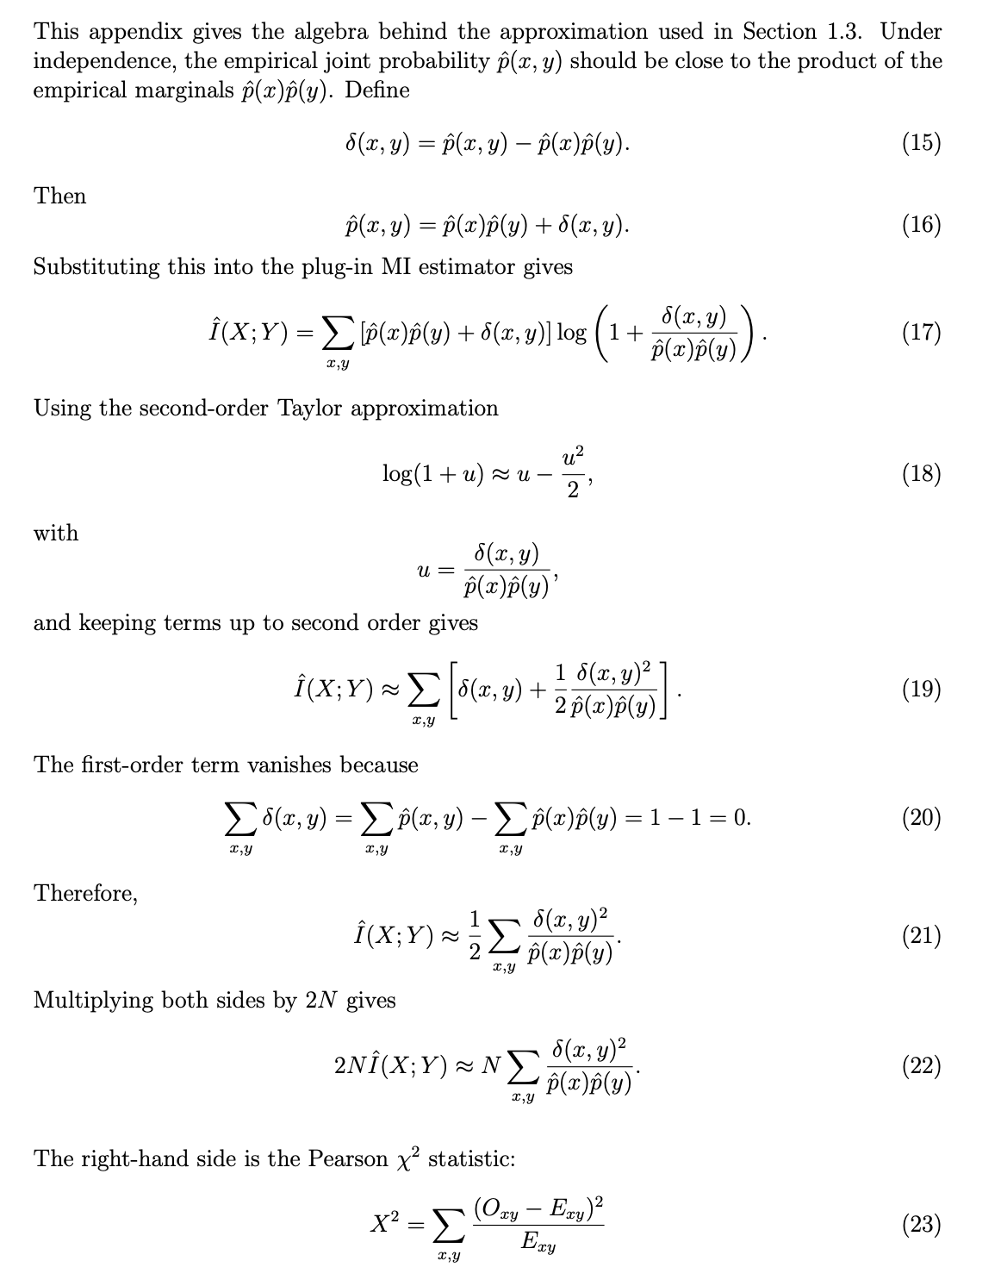
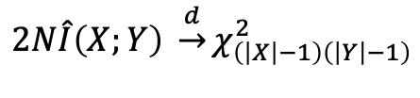
Literature Review: The Issues
We reviewed the existing literature on the derivation of the analytical null distribution for mutual information and identified two main issues with the current approaches.
Original Form
Critical Literature Review
Main Issues Discovered
Binomial Distr. Approximated to Normal Distr.
This approximation only works well in large sample regime
Analytical Null
Looking into original derivations of the Analytical Null…
(Key ref. Cover and Thomas [1], Paninski [8], Barnett and Bossomaier [12], Goebel et al. [30])
$$2N\hat{I}\left(X;Y\right) \underset{→}{d}χ_{\left(\left|X\right|−1\right)\left(\left|Y\right|−1\right)}^{2}$$
Second-order Taylor expansion around independence
Works poorly when variable X and Y are heavily skewed and under sampled
Notes:
Now before we get started, I am sure we have all heard on the news about how the US stock market is increasingly concentrated on a group of tech stocks known as the magnificent 7. However, little known is that our stock market similarly concentrated on a group of banking stock, as shown the screen here.
These 5 major banks make up to anywhere between 25% to 30% of our ASX200 index. In particular, CBA alone accounts for more than 10% of the index, and is now the worlds most expensive retail bank on a price to earning and price to book ratio.
Now, having the ASX200 being concentrated in these 5 stocks is problematic because it creates a market distortion effect, if there is strong share price dependence between these banks, the they will disproportionately drive the returns and volatility of the ASX200. Thus it will reduces the diversification benefits of investing in the ASX200 index directly.
Most Australians should be concerns as a lot of household wealth might be tied up in the ASX200 index through our investments in assets such as superannuation funds and index ETFs

Slide 7
Literature Review: Potential Solutions
We reviewed classical statistics literature and identified three methods that offer potential pathways for deriving a more accurate null distribution.
A
B
C
Exact Combinatorial
Enumeration
Effective Degrees
of Freedom
Moment-Matching and Parametric Approximation
Idea
Enumerate every contingency table consistent with the observed marginals
Keep χ² shape; replace nominal df with effective df from observed marginals
Match analytical moments of MI to a parametric family (gamma)
Key work
Fisher's exact test [22];
Kirkley [25]
Cliff et al. [26]; Satterthwaite [27]
Goebel et al. [30]
Strength
Exact null,
no asymptotic approximation
Reuses familiar χ² machinery
Closed-form, fast, no resampling
Gap
Combinatorial explosion
beyond small 2×2 tables
Unclear if changing df is sufficient
in a skewed, finite-sample regime
Marginal shape drops out due to truncating
at 2nd order Taylor Approximation
Notes:
Now before we get started, I am sure we have all heard on the news about how the US stock market is increasingly concentrated on a group of tech stocks known as the magnificent 7. However, little known is that our stock market similarly concentrated on a group of banking stock, as shown the screen here.
These 5 major banks make up to anywhere between 25% to 30% of our ASX200 index. In particular, CBA alone accounts for more than 10% of the index, and is now the worlds most expensive retail bank on a price to earning and price to book ratio.
Now, having the ASX200 being concentrated in these 5 stocks is problematic because it creates a market distortion effect, if there is strong share price dependence between these banks, the they will disproportionately drive the returns and volatility of the ASX200. Thus it will reduces the diversification benefits of investing in the ASX200 index directly.
Most Australians should be concerns as a lot of household wealth might be tied up in the ASX200 index through our investments in assets such as superannuation funds and index ETFs

Slide 8
Approach & Contributions
Building on the literature, we propose an approach to derive a corrected null distribution and outline three contributions that make our approach both practical and accessible
Approach
Primary route
Derive an exact closed-form finite-sample null distribution
Fallback Route
Derive an approximate correction to
the current analytical null distribution
Contributions
1
2
3
A “better” analytical
null distribution
Regime characterisation
JIDT toolkit integration
Notes:
Now before we get started, I am sure we have all heard on the news about how the US stock market is increasingly concentrated on a group of tech stocks known as the magnificent 7. However, little known is that our stock market similarly concentrated on a group of banking stock, as shown the screen here.
These 5 major banks make up to anywhere between 25% to 30% of our ASX200 index. In particular, CBA alone accounts for more than 10% of the index, and is now the worlds most expensive retail bank on a price to earning and price to book ratio.
Now, having the ASX200 being concentrated in these 5 stocks is problematic because it creates a market distortion effect, if there is strong share price dependence between these banks, the they will disproportionately drive the returns and volatility of the ASX200. Thus it will reduces the diversification benefits of investing in the ASX200 index directly.
Most Australians should be concerns as a lot of household wealth might be tied up in the ASX200 index through our investments in assets such as superannuation funds and index ETFs

Slide 9
Evaluation Plan
Our corrected null will be evaluated across 45 input configurations and benchmarked against both the chi-square analytical null and the resampled null.
Evaluation Method
Test Grid · 45 Configurations
Compare Three Methods
Alphabet size
2, 3, 6 outcomes
Corrected Null
(from this project)
χ² Analytical Null
(Baseline to Beat)
Resampled Null
(Ground Truth)
1
Sample size
N = 20, 50, 100, 200, 500
Evaluation Metrics
2
CDF overlay
do the null distributions match in shape?
Q–Q plot
do quantiles agree, especially in the tail used for thresholds?
False Positive Rate
does each threshold give FPR = nominal α for p-value tests
Marginal skewness
balanced, mild (70/30), strong (90/10)
3
Notes:
Now before we get started, I am sure we have all heard on the news about how the US stock market is increasingly concentrated on a group of tech stocks known as the magnificent 7. However, little known is that our stock market similarly concentrated on a group of banking stock, as shown the screen here.
These 5 major banks make up to anywhere between 25% to 30% of our ASX200 index. In particular, CBA alone accounts for more than 10% of the index, and is now the worlds most expensive retail bank on a price to earning and price to book ratio.
Now, having the ASX200 being concentrated in these 5 stocks is problematic because it creates a market distortion effect, if there is strong share price dependence between these banks, the they will disproportionately drive the returns and volatility of the ASX200. Thus it will reduces the diversification benefits of investing in the ASX200 index directly.
Most Australians should be concerns as a lot of household wealth might be tied up in the ASX200 index through our investments in assets such as superannuation funds and index ETFs

Slide 10
Research Plan
The project will be delivered across five milestones, spanning from Semester 1 Week 10 to Semester 2 Week 13, covering derivation, implementation, evaluation and final write-up.
Sem 1, Week 10
Sem 2, Week 4
Sem 2, Week 6
Sem 2, Week 8
Sem 2, Week 13
Survey and test the three routes; identify
most promising approach
Derive and implement the chosen correction
in Python
Grid-based testing, characterisation of
regimes, JIDT integration
Thesis Writing
and finalisation
Finish Thesis!
Notes:
Now before we get started, I am sure we have all heard on the news about how the US stock market is increasingly concentrated on a group of tech stocks known as the magnificent 7. However, little known is that our stock market similarly concentrated on a group of banking stock, as shown the screen here.
These 5 major banks make up to anywhere between 25% to 30% of our ASX200 index. In particular, CBA alone accounts for more than 10% of the index, and is now the worlds most expensive retail bank on a price to earning and price to book ratio.
Now, having the ASX200 being concentrated in these 5 stocks is problematic because it creates a market distortion effect, if there is strong share price dependence between these banks, the they will disproportionately drive the returns and volatility of the ASX200. Thus it will reduces the diversification benefits of investing in the ASX200 index directly.
Most Australians should be concerns as a lot of household wealth might be tied up in the ASX200 index through our investments in assets such as superannuation funds and index ETFs

Slide 11
Appendix: References
Key references from Assignment 3 underpinning the literature review, methodology and the three potential approaches presented in this presentation.
[1] Cover, T. M., & Thomas, J. A. (2006). Elements of Information Theory (2nd ed.). Wiley-Interscience.
[8] Paninski, L. (2003). Estimation of entropy and mutual information. Neural Computation, 15(6), 1191–1253.
[9] Treves, A., & Panzeri, S. (1995). The upward bias in measures of information derived from limited data samples. Neural Computation, 7(2), 399–407.
[12] L. Barnett and T. Bossomaier, “Transfer entropy as a log-likelihood ratio,” Physical
Review Letters, vol. 109, no. 13, p. 138105, 2012.
[13] Lizier, J. T. (2014). JIDT: An information-theoretic toolkit for studying the dynamics of complex systems. Frontiers in Robotics and AI, 1, 11.
[16] Shannon, C. E. (1948). A mathematical theory of communication. The Bell System Technical Journal, 27(3), 379–423.
[17] Kraskov, A., Stögbauer, H., & Grassberger, P. (2004). Estimating mutual information. Physical Review E, 69(6), 066138.
[21] Roulston, M. S. (1999). Estimating the errors on measured entropy and mutual information. Physica D, 125(3–4), 285–294.
[22] Fisher, R. A. (1922). On the interpretation of χ² from contingency tables, and the calculation of P. Journal of the Royal Statistical Society, 85(1), 87–94.
[23] Agresti, A. (1992). A survey of exact inference for contingency tables. Statistical Science, 7(1), 131–153.
[24] Mehta, C. R., & Patel, N. R. (1983). A network algorithm for performing Fisher's exact test in r×c contingency tables. JASA, 78(382), 427–434.
[25] Kirkley, A. (2025). Transfer entropy for finite data. Physical Review E, 112(5), L052304.
[26] Cliff, O. M., Novelli, L., Fulcher, B. D., Shine, J. M., & Lizier, J. T. (2021). Assessing the significance of directed and multivariate measures of linear dependence between time series. Physical Review Research, 3(1), 013145.
[27] Satterthwaite, F. E. (1946). An approximate distribution of estimates of variance components. Biometrics Bulletin, 2(6), 110–114.
[28] Welch, B. L. (1947). The generalization of "Student's" problem when several different population variances are involved. Biometrika, 34(1–2), 28–35.
[29] Box, G. E. P. (1954). Some theorems on quadratic forms applied in the study of analysis of variance problems, I. Annals of Mathematical Statistics, 25(2), 290–302.
[30] Goebel, B., Dawy, Z., Hagenauer, J., & Mueller, J. (2005). An approximation to the distribution of finite sample size mutual information estimates. In IEEE ICC (Vol. 2, pp. 1102–1106).
Notes:
Now before we get started, I am sure we have all heard on the news about how the US stock market is increasingly concentrated on a group of tech stocks known as the magnificent 7. However, little known is that our stock market similarly concentrated on a group of banking stock, as shown the screen here.
These 5 major banks make up to anywhere between 25% to 30% of our ASX200 index. In particular, CBA alone accounts for more than 10% of the index, and is now the worlds most expensive retail bank on a price to earning and price to book ratio.
Now, having the ASX200 being concentrated in these 5 stocks is problematic because it creates a market distortion effect, if there is strong share price dependence between these banks, the they will disproportionately drive the returns and volatility of the ASX200. Thus it will reduces the diversification benefits of investing in the ASX200 index directly.
Most Australians should be concerns as a lot of household wealth might be tied up in the ASX200 index through our investments in assets such as superannuation funds and index ETFs

